Slide 1
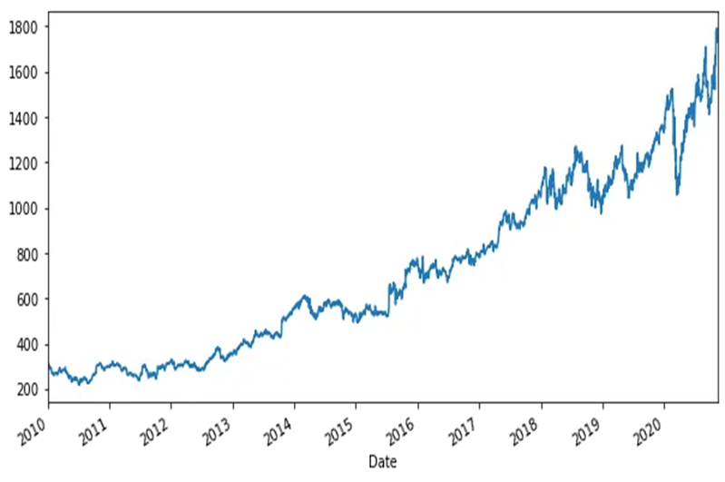
What is time series data?
Sequentailly ordered over time
Observation are typically collected at regular intervels
Every Seconds/Minutes/Hours
Daily
Monthly
Yearly and trend in time series analysis

Slide 2
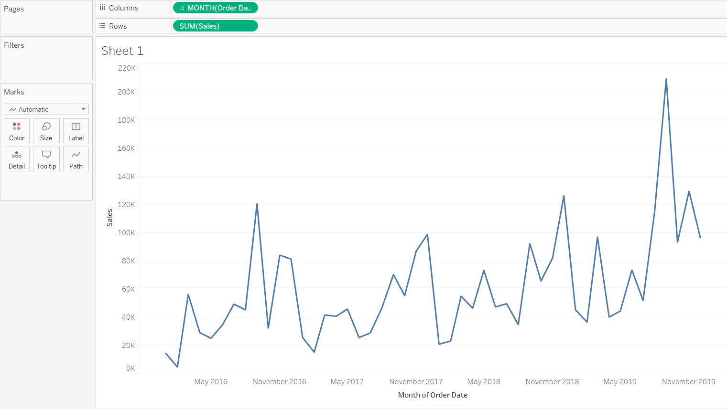
Examples
Weather data
Rainfall measurements
Temperature readings
Quarterly sales
Stock prices
Automated stock trading
Interest rates

Slide 3
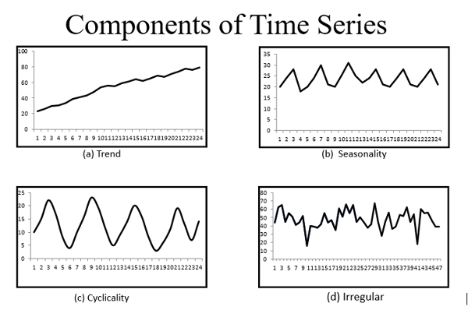
Time Series
A time series is a sequence of data points that occur in successive order over some period of time.
KEY CONCEPT
Trend
Seasonality
Cyclic
Irregular

Slide 4
Components of Time Series
Trend: The linear increasing or decreasing behavior of the series over time.
Seasonality: The repeating patterns or cycles of behavior over time.
Cyclic:Due to the business cycle and every organization has to phase all the four phases of a business cycle such as boom, recession, depression, and recovery
Noise[Irregular]: The variability in the observations that cannot be explained by the model.

Slide 5
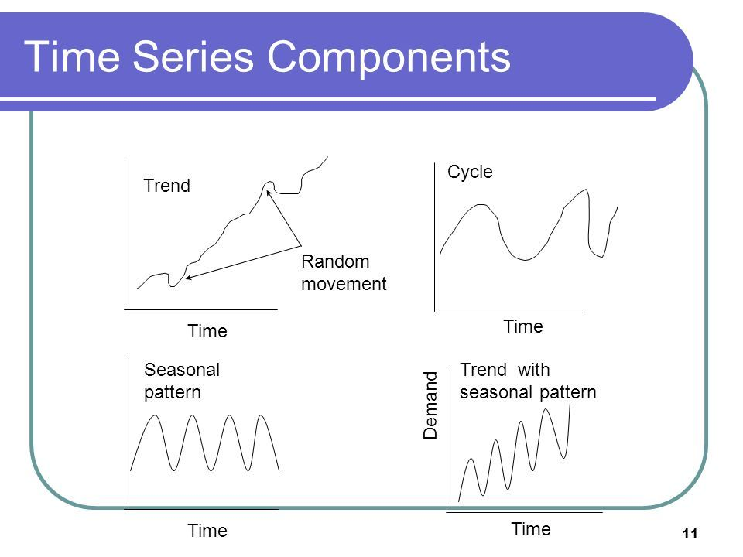

Slide 6
Stationary Time Series
A time series is considered stationary if its statistical properties, such as mean, variance, and autocorrelation, remain constant over time.
There are two types of stationarity:
Strict Stationarity: The entire probability distribution of the data is time-invariant.
Trend Stationarity (Weak Stationarity): The mean, variance, and autocorrelation are constant over time, but not necessarily the entire probability distribution.
Example Stationary time Series
period | Value
1 | 7
2 | 5
3 | 7
4 | 6
5 | 8

Slide 7
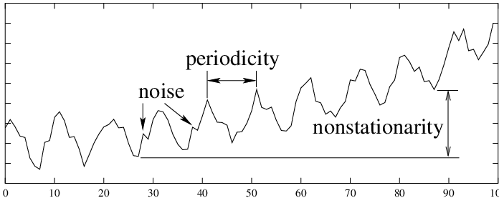
Non-Stationary Time Series
A non-stationary time series, on the other hand, exhibits statistical properties that change over time. This could involve trends, seasonality, or other patterns that make it difficult to model and predict accurately.
Example Non-Stationary Time Series
Time Period | value
1 | 10
2 | 15
3 | 22
4 | 28
5 | 35

Slide 8
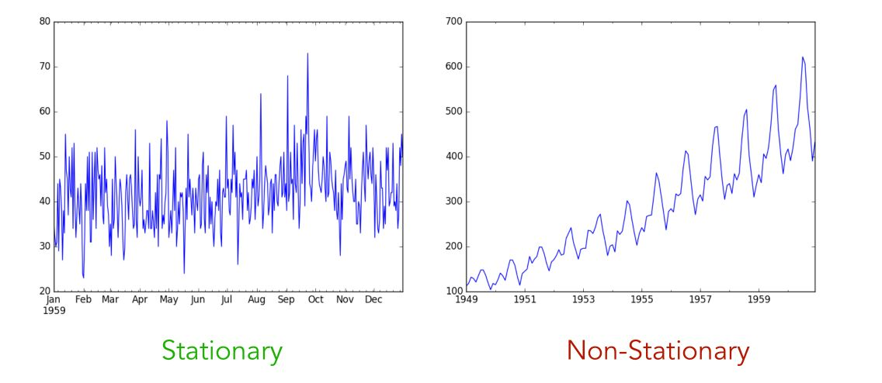

Slide 9
Seasonal and Non-stationary alerts
A time series is said to be stationary when its statistical properties do not change over the time at which the series is observed.
Conversely, a time series is non-stationary when its statistical properties depend on time
time series with trends and seasonality is not stationary — these phenomena can affect the value of the time series at different times

Slide 10
Rolling Statistics
Rolling statistics are a tool often used in time series analysis to assess the stationarity of a time series.
Stationarity is a crucial assumption for many time series models, and rolling statistics help in visually and quantitatively identifying trends or seasonality in the data.
Rolling Mean (Moving Average):
This involves calculating the mean of a certain number of adjacent data points in a time series.
Rolling Standard Deviation:
Similar to the rolling mean, this involves calculating the standard deviation over a moving window.

Slide 11
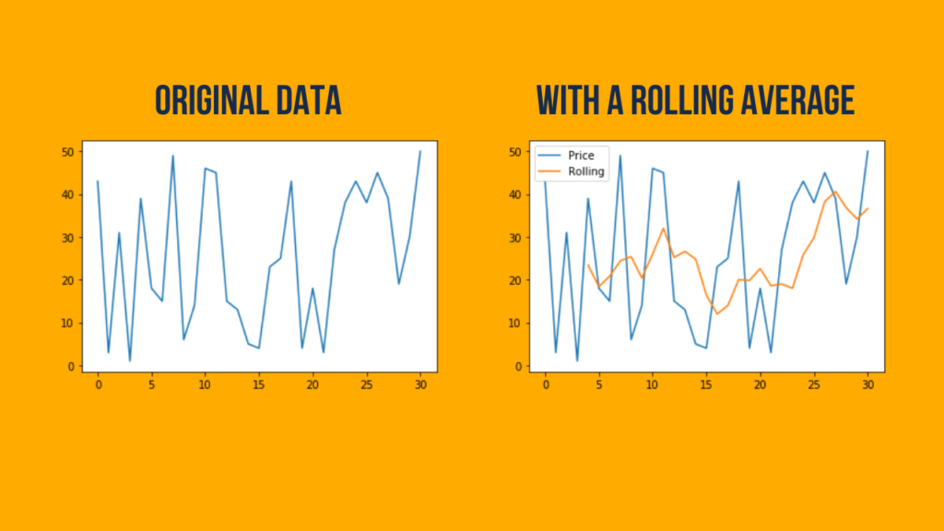

Slide 12
Procedure:
Calculate Rolling Mean:
  Choose a window size (e.g., 3 periods).
  Calculate the mean for the first three values, then move the window and calculate for the next three, and so on.
  If the rolling mean shows an increasing or decreasing trend, the series is likely non-stationary.
Calculate Rolling Standard Deviation:
  Similar to the rolling mean, calculate the standard deviation over the chosen window.
  A changing pattern in the rolling standard deviation indicates non-stationarity.
Time | T1 | T2 | T3 | T4 | T5
Value | 300 | 310 | 420 | 530 | 640
Moving average | -- | M=(300+310)/2=305 | M=(310+420)/2=365 | M=(420+530)/2=475 | M=(530+640)/2=585

Slide 13
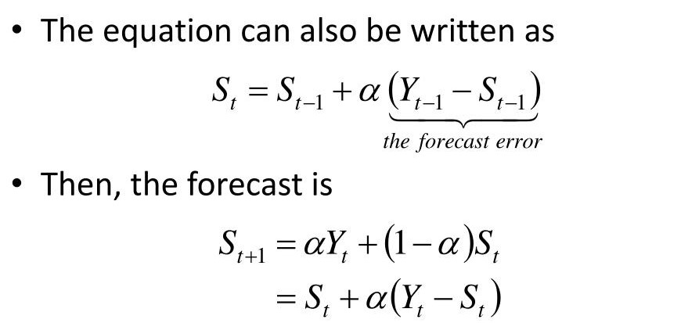
Exponential Smoothing
Exponential smoothing is a time series forecasting method for univariate data that can be used to predict future data points by giving more weight to recent observations while gradually decreasing the weight of older observations.
The formula for simple exponential smoothing :

Slide 14
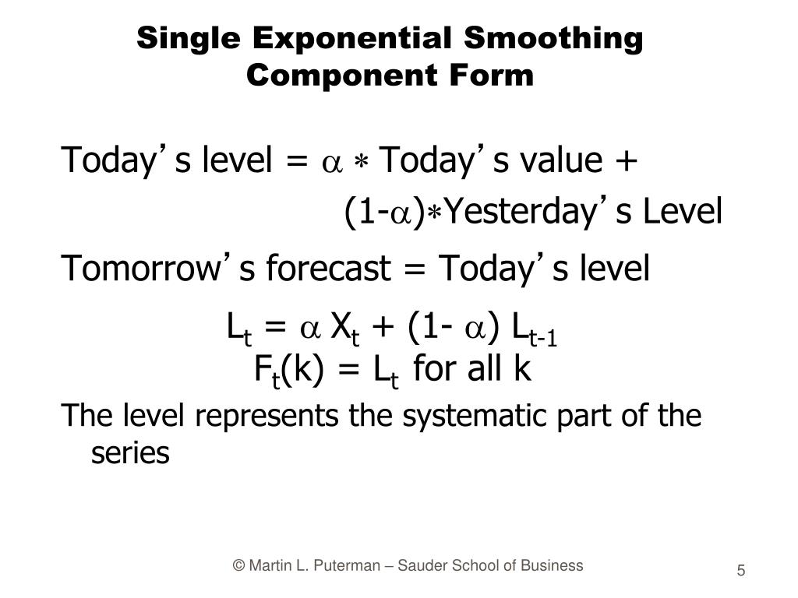

Slide 15
Exponential Smoothing
Independent and dependent variables
time series dataset
Year of experience | Salary
2 | 25000
3 | 28000
5 | 30000
6 | 32000
8 | 35000
9 | 38000
12 | ?
Time | 00.00 am | 3.00 am | 6.00 am | 9.00 am
Stock price | 123 | 230 | 201 | ?
20%.
80%.

